Slide 1

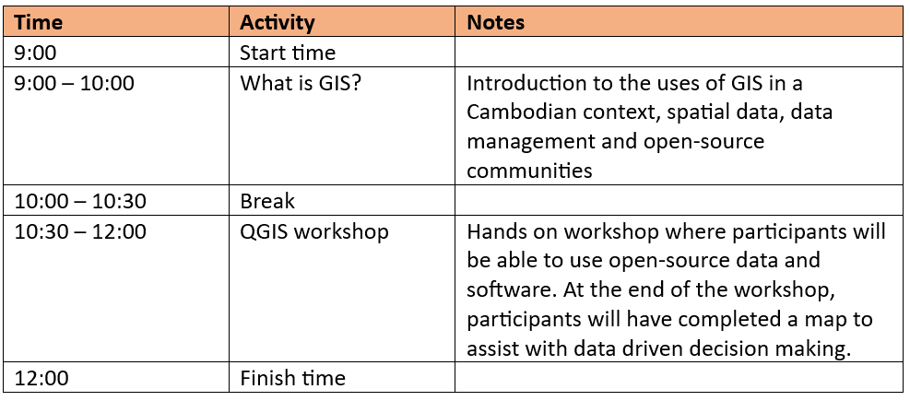
Introduction to QGIS Workshop

Slide 2
Download required files:
All download links and resources we discuss today are available at:
https://github.com/lbannan/next-gen-qgis-workshop
Please take a minute to open this link on your browsers.
If you are using your own device and have not already done so, please download the required software now:
Scroll down to ‘Downloads’
Download and install the QGIS software, worksheet and sample data packs

Slide 3
Introduction to QGIS
National University of Battambang, Cambodia
2 February 2024
Presented by: Le-Anne Bannan
leanne.bannan@unimelb.edu.au

Slide 4




What is GIS?
GIS stands for Geographic Information Systems (or Geographic Information Science) and you probably use it most days!

Slide 5
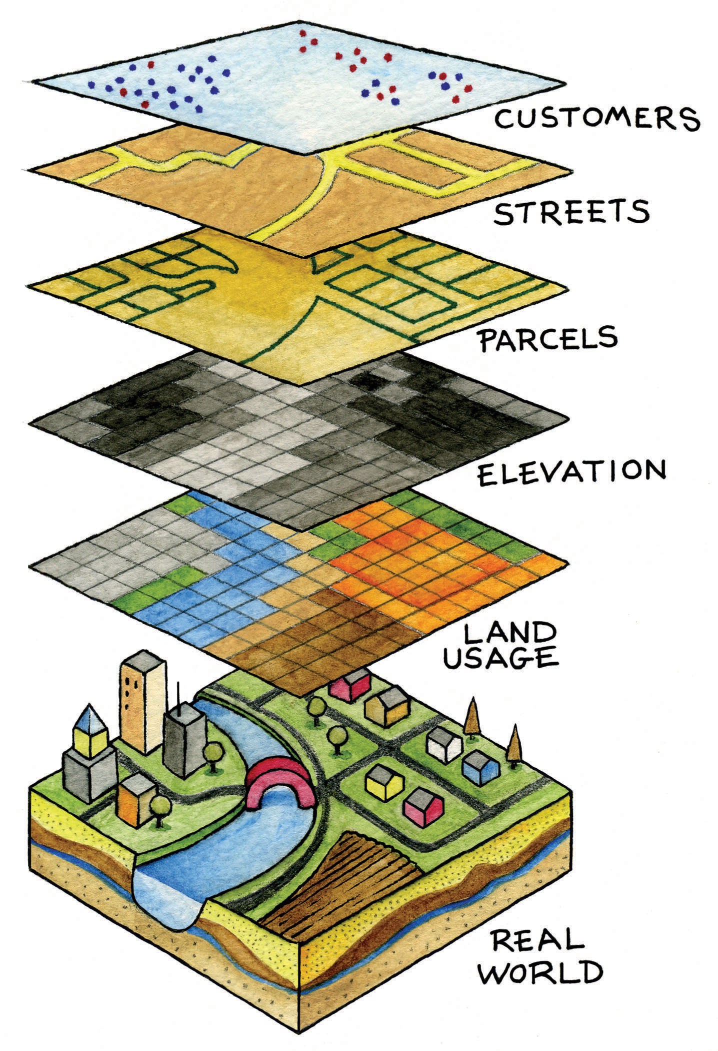
What do we do with GIS?
Visualise, manage and analyse spatial data
Conduct spatial analysis
Create maps
Image: ‘Layers’ of spatial data, Campbell and Shin (2011)

Slide 6
Why QGIS?
QGIS is an open-source and free GIS program
Easy to use (graphical interface and compatible with coding languages such as python and R)
Has a significant user-base and extensive online documentation

Slide 7
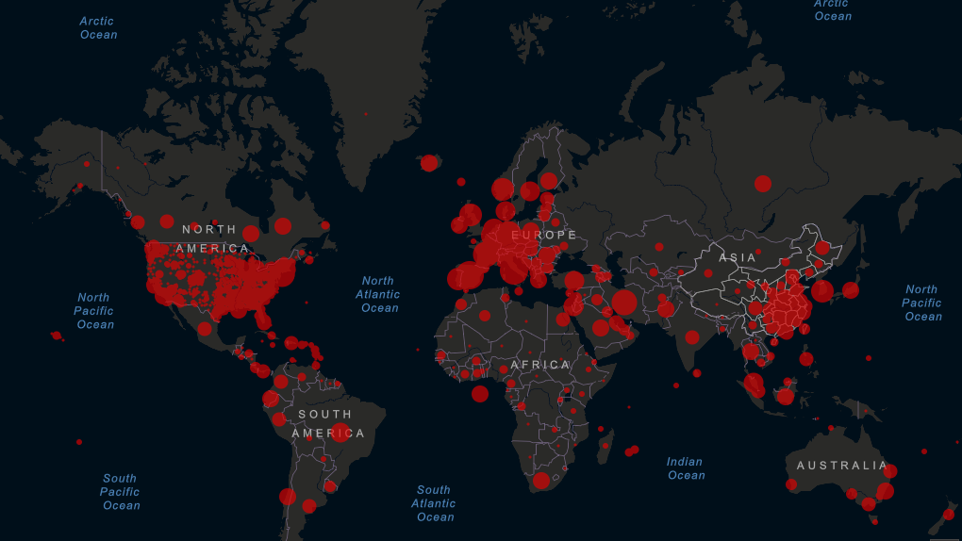
What is spatial analysis?
The process of examining and interpreting patterns and relationships between geographic data to understand and derive meaningful insights.
Common uses:
Epidemiology (COVID-19 outbreaks)
Transport and logistic mapping
Landcover analyses
Archaeology (LiDAR)
Weather forecasts
Image: John Hopkins University COVID-19 Dashboard

Slide 8
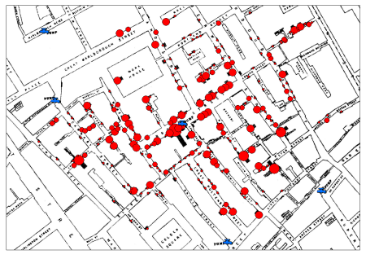
Dr John Snow’s Map of Cholera
The most famous example of spatial analysis in the GIS community
Supported the (then) new theory of cholera being waterborne through spatial analysis
Read the full story here.
Map layers:
street map of Soho, London (black)
reported deaths from cholera (red)
map of water pumps (blue)
Image: Snow (1855), distributed by ESRI

Slide 9

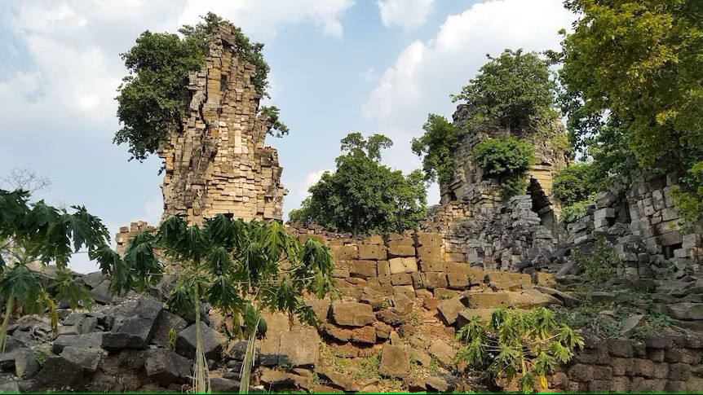
An example from Cambodia: Angkor LiDAR
Images: LiDAR helicopter, Cambodian Archaeological Lidar Initiative (2015) and Preah Khan of Kampong Svay, ABC (2016)

Slide 10
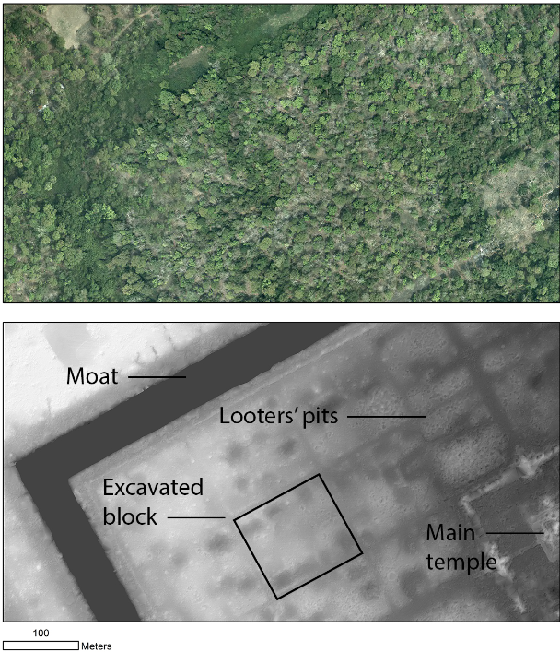
An example from Cambodia: Angkor LiDAR
International research team lead by Prof. Roland Fletcher and Dr Damian Evans (University of Sydney)
Used LiDAR (Light Detection and Ranging) which can effectively map topography of an area beneath vegetation
Completely transformed Western researcher’s assumptions of the Angkor empire from a network of separated ‘temple-cities’ to a wide network which supported much larger populations than originally thought
Research is ongoing with this data to reveal further details about South-East Asian history with GIS
Image: Preah Khan of Kampong Svay, Cambodian Archaeological Lidar Initiative (2015)

Slide 11
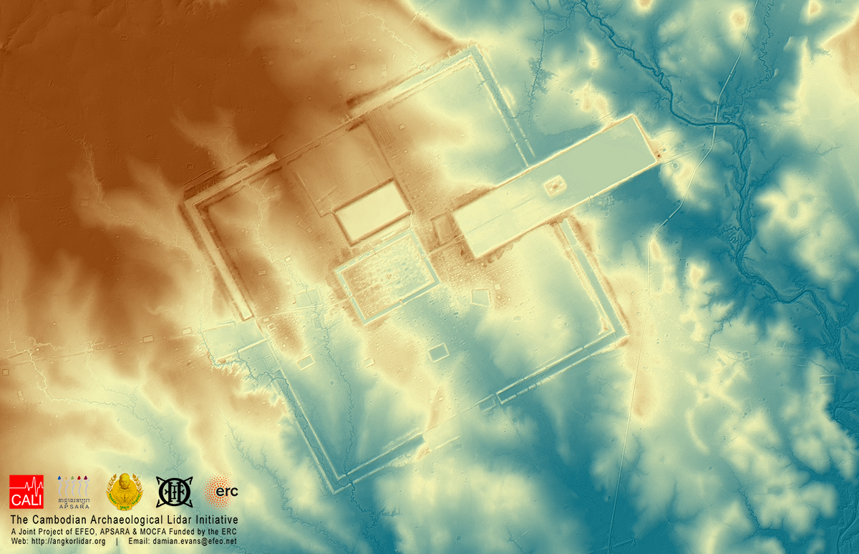
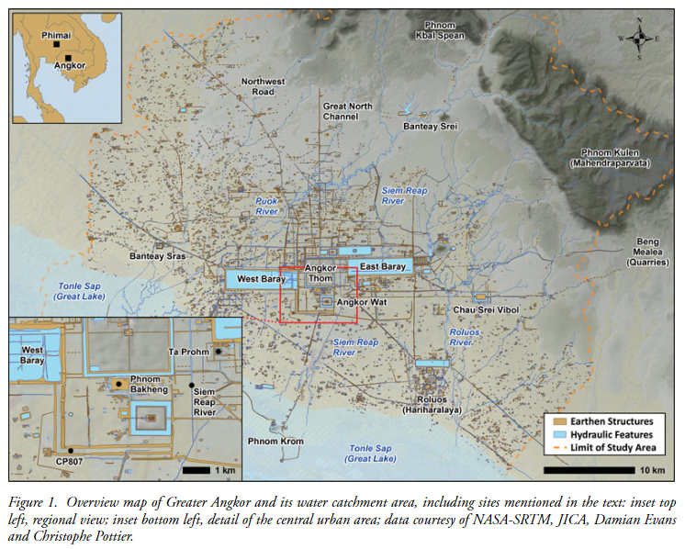
An example from Cambodia: Angkor LiDAR
Images: Preah Khan of Kampong Svay, Cambodian Archaeological Lidar Initiative (2015) and Overview map of Greater Angkor (Evans, 2015)

Slide 12


Slide 13
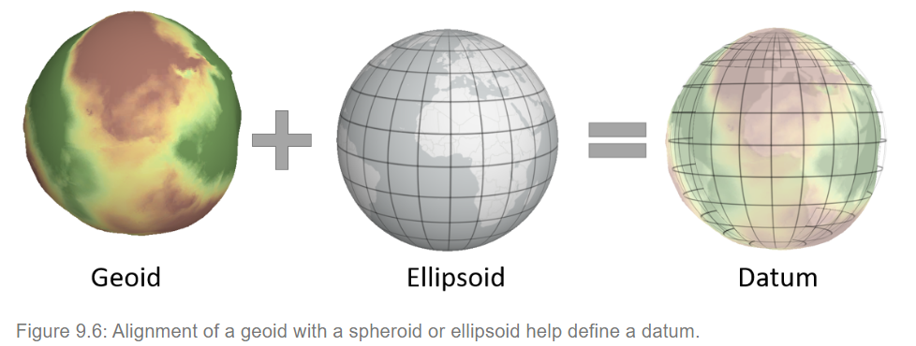
The language of location
Location and spatial data on the Earth’s surface can be thought of as a language or system
Geodetic surveys are important forms of data collection which translate the Earth’s surface into a series of reference points
Accurate data storage, communication and representation is very important for GIS
These reference systems are frequently updated and many systems exist – always find out which one your data is in!
Image: Coordinate Systems, Gimond (2023)

Slide 14
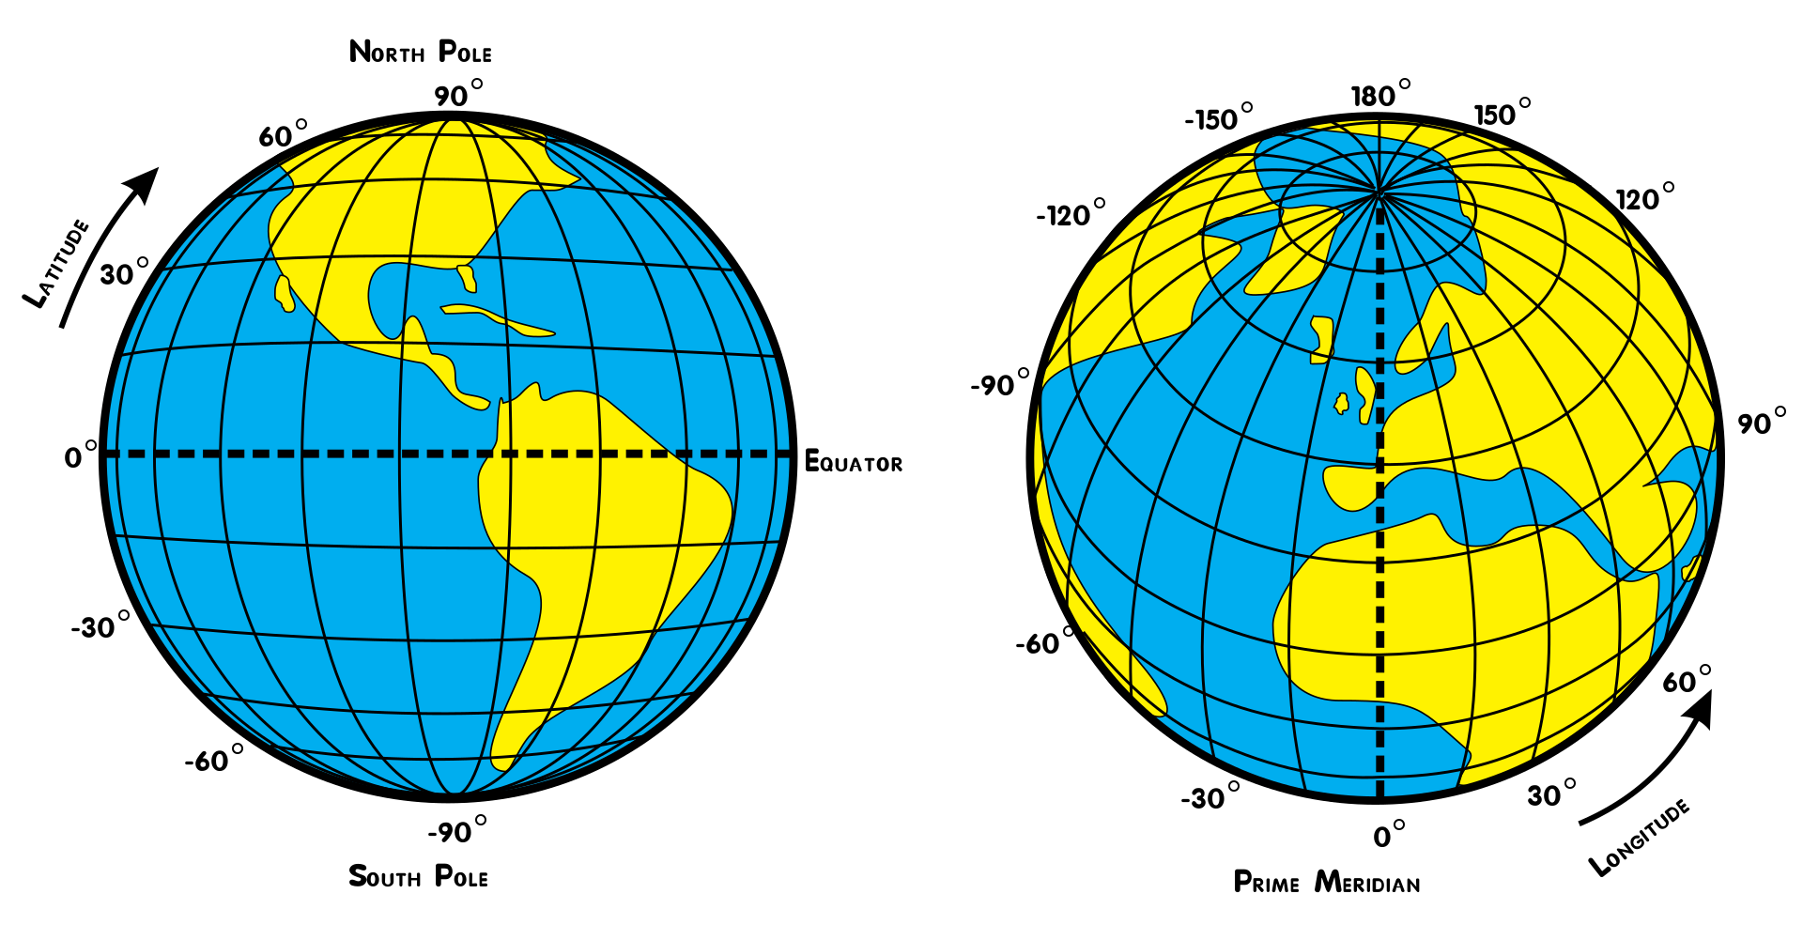
Geographic Coordinate Systems
Most web-based applications will use the ‘World Geodetic System 1984’(WGS 84) as a reference standard
Location on the Earth’s surface (For example: latitude, longitude)
Each coordinate system will use different reference points to store information about locations
Knowing which geographic coordinate system your data is referring to is vital to making useful and accurate maps
Image: Latitude and longitude, Wikicommons (2024)

Slide 15
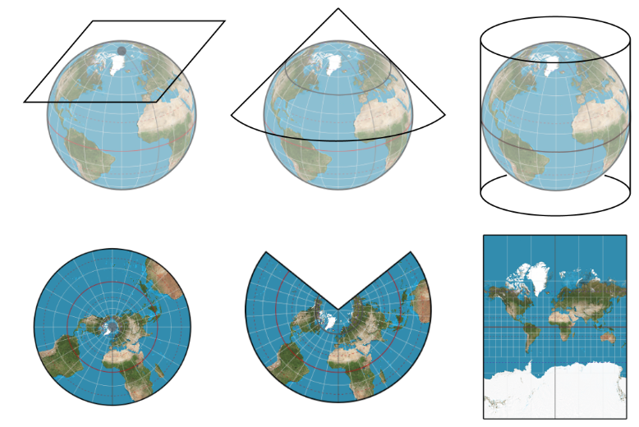
Projections
As the Earth is round, we must ‘project’ it onto a flat surface to create a map
These are known as ‘map projections’
All projections will distort area, distance, angle (or any combination of the three)
Different projections can visualize the same data in different ways
You cannot perform spatial analysis correctly without knowing which projection your data is in
A helpful YouTube video to explain
Image: Planar, conical and cylindrical map projections (Battersby, 2017)

Slide 16
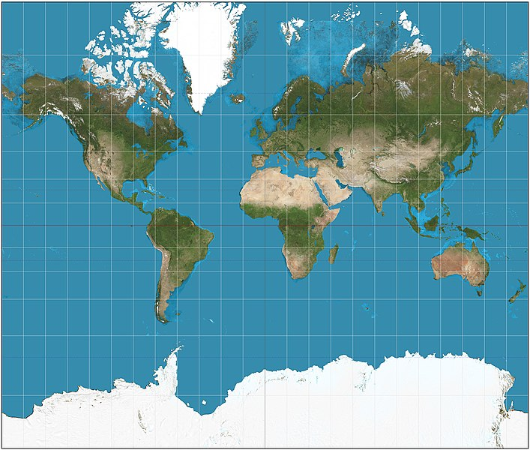
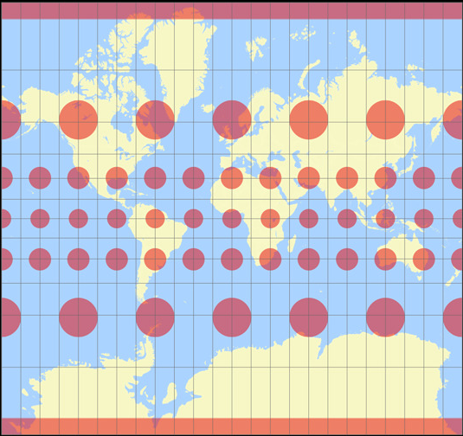
The most famous projection (and its distortions)
The Mercator Projection is the most recognisable projection
Although angles are preserved in this projection, area and shape are actually distorted
See this website for further information
Image: The Mercator projection (Wikicommons, 2024) and the Mercator Tissot Indicatrix

Slide 17
Geographic Data
All geographic data is a representation of the real world
We separate different features (trees, people, streets, rivers, buildings, etc) into layers
When we overlay these representations, we are able to reveal spatial relationships and patterns
There are two types of geographic data:
Vector data (points, lines and polygons)
Raster data (pixels or grids)
Image: ‘Layers’ of spatial data, Campbell and Shin (2011)

Slide 18
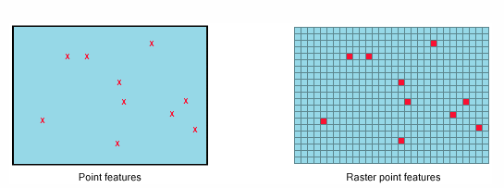
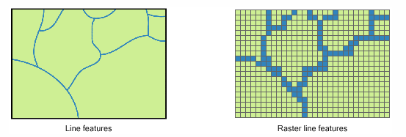
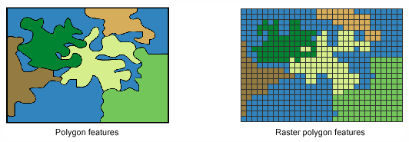
Geographic Data: Vector or raster?
Any object can be represented as either vector or raster. It just depends on what type of analysis is being conducted. For this workshop, we will be using vector data.
Information on the differences between vector and raster representations can be found here.
Image: Two ways to represent the same feature (ESRI, 2024)

Slide 19




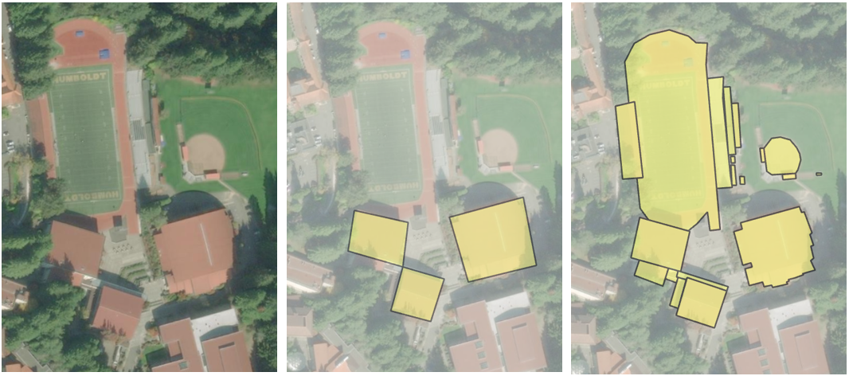
Where does the data come from?
All georeferenced imagery can be used as spatial data in a GIS
Most commonly, datasets will be created by surveyors, NGOs, or government through various methods
Knowing who collected your data, when and why is very important before using it to make decisions
Image: Apple Airtag
Image: Government Agencies
Image: Surveyors
Image: CommCare app
Image: Georeferenced imagery

Slide 20
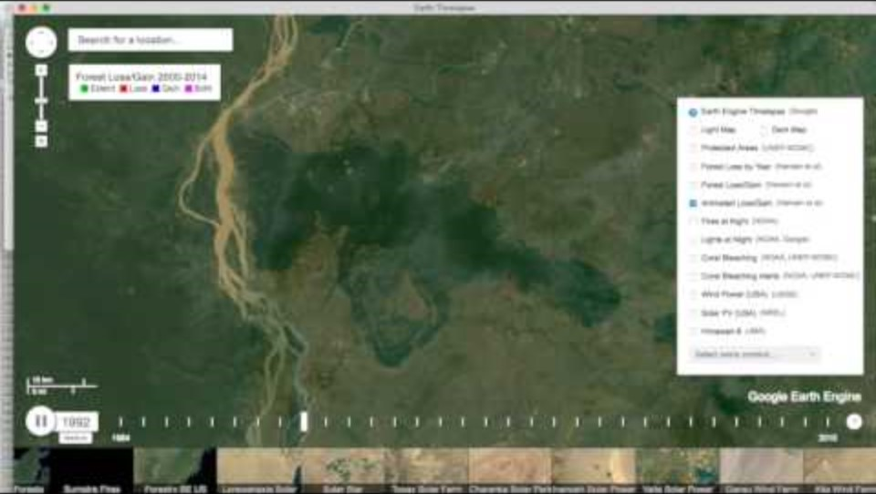
The politics of data
Maps are authoritative visualisations – people will often trust what is shown on a map (Griffin, 2020)
As GIS technologies become more common, so too are unreliable maps
Maps can be manipulated to support certain political goals and motivations (Frewer and Chan, 2014)
It is all dependent on the data and the way it is visualised
There is an ethical responsibility to create maps with the best information available and be honest with your findings
Video: Forest loss in Cambodia (2017)

Slide 21



How can I access reliable data?
At this stage, there is no official spatial data repository in Cambodia
Only use data from reputable organizations who publish their sources and any affiliations
Check for metadata – where was the data captured? By who? Why? When?
Does the data have a record of the Global Coordinate System used?
If your data isn’t well documented – don’t use it!
See the GitHub repository for links to these spatial data repositories and more
Image: Open Development Cambodia (2024)
Image: USAID DHS Program (2024)
Image: UN Food and Agriculture Organisation (2024)

Slide 22
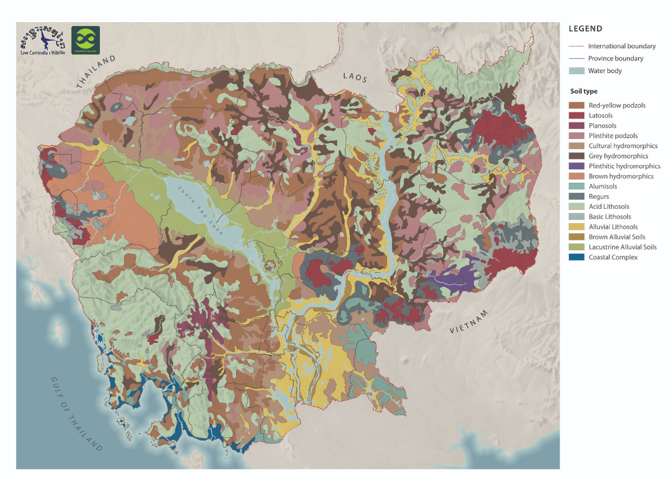
Examples of Cambodian data
Image: Distribution of soil types in Cambodia (Crocker, 1962)

Slide 23
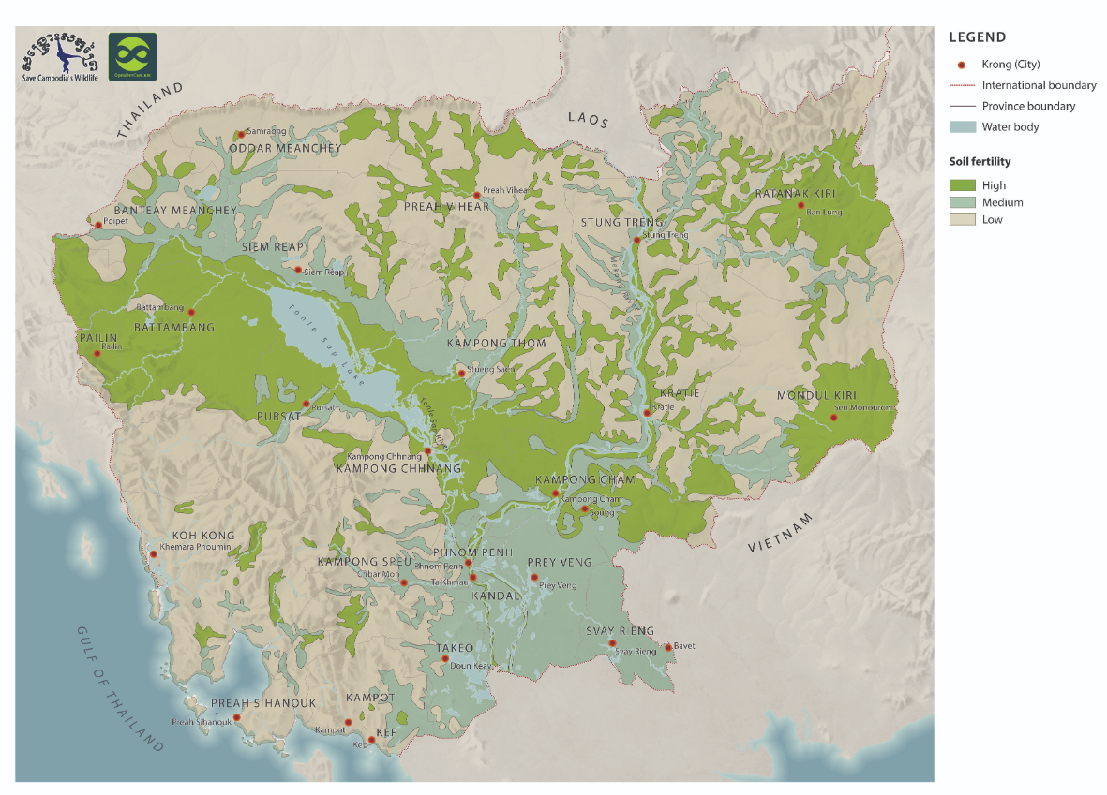
Examples of Cambodian data
Image: Soil fertility map (2003)

Slide 24
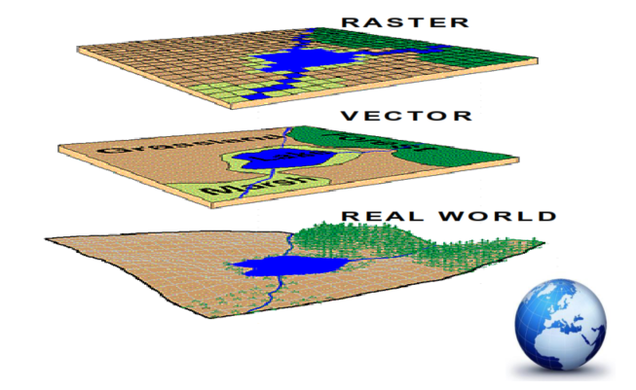
Some basic tips for GIS success:
Your analysis is only as reliable as the data you put into it! Try to find data from up to date, trustworthy sources
Keep all of your files in one folder and beware of moving these files - you may lose your hard work
Always keep a document detailing where your data has come from and when it was retrieved
Use short file names with no spaces
For example: ‘Cambodia Rivers’ vs ‘camb_rivers’
Save, save, save your project and then save it again!

Slide 25


Slide 26








Our partners

Slide 27
Let’s get started in QGIS:
https://github.com/lbannan/next-gen-qgis-workshop
Navigate to ‘Downloads’ in the above GitHub repository
Download worksheet and sample data pack
Before trying your next project, read through ‘Further Resources’ on the GitHub repository for some great tutorials and more detailed explanations of everything we have covered in this presentation

Slide 28
References:
All images and materials referenced in-slide unless otherwise specified. See GitHub repository for further resources and information.
Chang, K. T. (2015). Introduction to geographic information systems. Boston: Mcgraw-hill.
Frewer, T., & Chan, S. (2014). GIS and the ‘Usual Suspects’-[Mis]understanding Land Use Change in Cambodia. Human Ecology, 42(2), 267–281. https://doi.org/10.1007/s10745-013-9639-z
Griffin, A. L. (2020). Trustworthy maps. Journal of Spatial Information Science, 20, 5–19. https://doi.org/10.5311/JOSIS.2020.20.654
Nelson, T. A., Goodchild, M. F., & Wright, D. J. (2022). Accelerating ethics, empathy, and equity in geographic information science. Proceedings of the National Academy of Sciences, 119(19), e2119967119. https://doi.org/10.1073/pnas.2119967119
Phnom Penh Post (2020). Forest watchdog warned against satellite imagery. https://www.phnompenhpost.com/national/forest-watchdog-warned-against-satellite-imagery

Slide 29
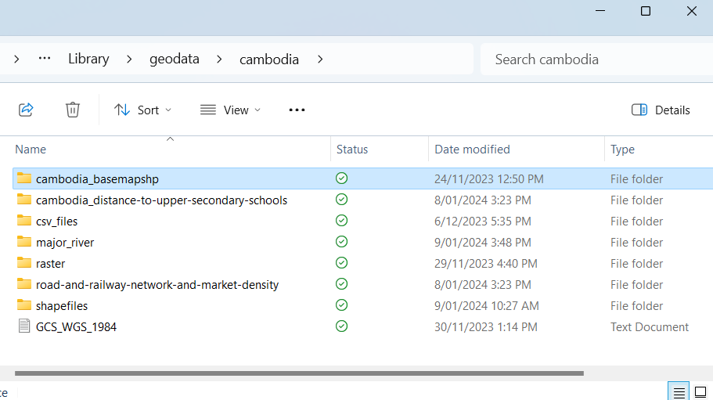
Spatial Data Structures and Types
Just like images files are commonly jpeg (.jpg) or portable network graphics (.png), spatial data have their own formats too
Today we will be using shapefiles (.shp)
QGIS combines these two file formats in a geopackages which appear as several separate but related files in a directory
You should always save your original data and your working data in separate locations with documentation about the source, geographic coordinate systems, projections and any transformations you have performed throughout your project

Slide 30

How did we go? Please take five minutes to provide your feedback on this workshop by following the QR code or visiting this website:
http://tinyurl.com/kfhem2xu

